Slide 1
Building a Data Catalog
Mandy Chessell, IBM

Slide 2
Coco Pharmaceuticals persona
https://odpi.github.io/data-governance/coco-pharmaceuticals/personas/

Slide 3
Contents of the Asset Catalog

Slide 4
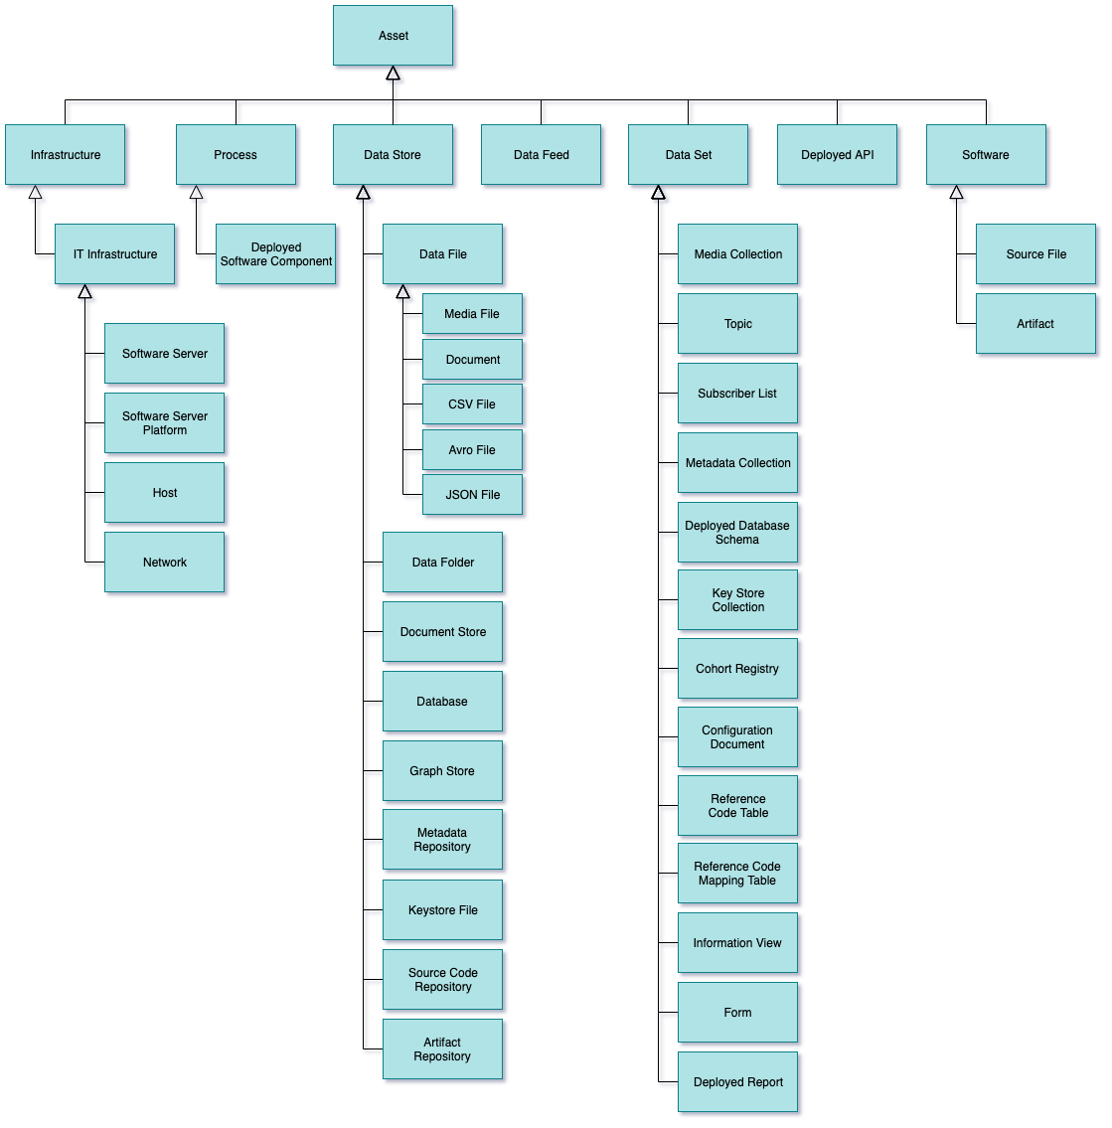
Types of Asset
Infrastructure – hardware and software generic “platforms”.
Process – well defined sequence of actions.
DataStore – data at rest
DataFeed - data in motion
DataSet – collection of data
DeployedAPI – interface
Software – parts for IT system

Slide 5
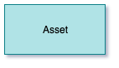
Asset Properties
Properties:
Open Metadata Unique identifier (GUID) - this a globally unique id across all metadata instances. It is a string of letters and numbers and typically looks something like this 40d9520b-dbc0-4cc4-9bad-03ab72d027f3 and is assigned by Egeria.
Qualified Name - this is a globally unique name of the asset - it is unique across all assets It is assigned by the creator of the asset.
Display Name - typically qualified names are long in order to make them unique. The display name is a short name used in reports and other displays of asset information.
Description - description of the asset.
Additional Properties - names and values of additional properties that the organization wants to record about the asset.
Usage
With the basic asset properties defined, the asset catalog provides a searchable list of the assets of the organization. The content provides in the names, descriptions and additional properties will determine how easy it is to retrieve specific assets.

Slide 6
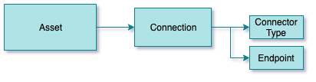
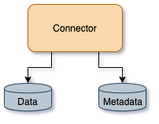
Connections
A connection the information necessary to create a connector to the asset.
The connector is a client to both the data and the information about the asset stored in open metadata. Some connectors use the metadata about the asset to control what data can be retrieved from the asset depending on the caller.
Usage
The connector that is generated from the connection object enables both tools and applications to use the asset through a governed interface that provides metadata, data and, in some cases, metadata-driven access control.

Slide 7
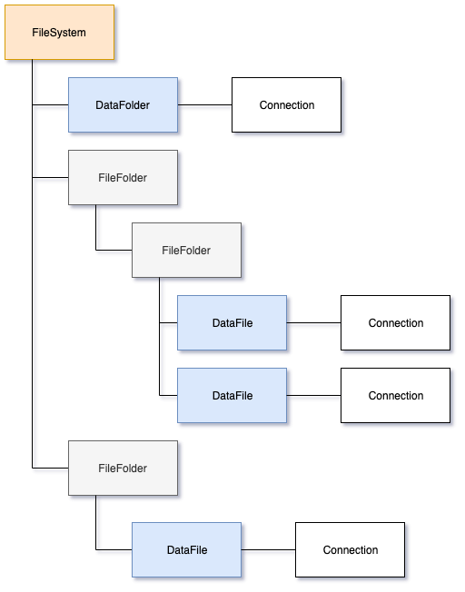
Not all assets need a connection
A connection is only needed if applications/tools needs to access its contents.

Slide 8
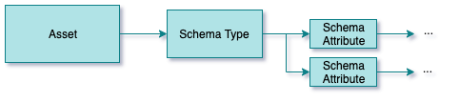
Schemas
A schema describes the individual data fields and operations of the asset. It is organized to reflect the internal organization of the asset and so acts as a guide to the types of content in the asset and how to navigate around it.
Usage
With the schema in place, it is possible to search for assets based on the type of data, or type of operations that the asset supports.

Slide 9
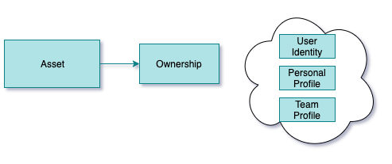
Asset Owners
Asset ownership defines who is responsible for the asset. This covers ensuring the catalog entry is correct, the contents of the asset are complete and correct and controlling access to the asset.
The owner can be defined as a user identity, a personal profile or a team profile. These definitions are managed by the Community Profile OMAS.
Usage
With an owner established, it records who is responsible for the protection and quality of the asset. It is possible to route requests from the consumers of the asset to the owner. An example of this is in managing queries about the content of the asset and requests for access to its contents.

Slide 10
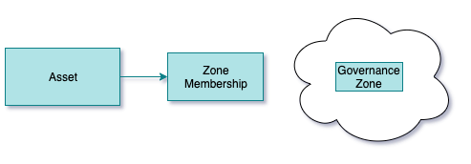
Governance Zones
Governance Zones allow assets to be grouped according to their usage. It is possible to assign supported zones to Egeria’s Open Metadata Access Services (OMASs) to limit the scope of assets that are returned from searches.
Usage
Using governance zones allows the organization to scope the assets that are returned to a community of users who are using the asset catalog.
The governance zones can also be used to define the group of assets that an automated process should process.

Slide 11
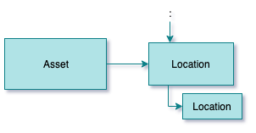
Asset Location
Egeria supports the definition of a location model that divides both physical and digital space into hierarchies with cross links between the hierarchies. This means it is possible to link the assets to their location(s)
Usage
Attaching assets to location definitions means it is possible to use details of the location as part of the search for assets.
Knowing the asset location, whether it is a physical or digital location can also help with demonstrating that data sovereignty is being respected and the level of risk that is allocated in a particular location.

Slide 12
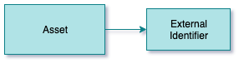
External Identifiers
A specific asset may be represented in different tools using different names. It is possible to add details of all of these external identifiers to the Asset.
Usage
Knowing all the names of an asset means that the asset catalog can support searches for assets using the name that specific communities of people know.
It also helps automated process that are operating on the physical asset through a particular tool or API can look up the appropriate identifier for the asset for that tool/API.

Slide 13
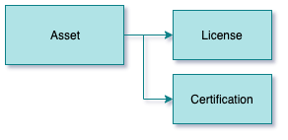
License and Certifications
An asset can have its license and/or certifications attached to it.
The license determines the terms and conditions of use for the asset. This becomes important particularly when assets come from an external organization.
Certifications typically relate to a regulation or standard or DevOps quality gate. When the certification is tied to the asset it means that the asset has passed the requirements.
Usage
Attaching licences and certifications to assets raises awareness of the any restrictions on the use of the assets and to what standards they are managed to. If the licenses and certifications are machine readable, automated processes can used them to control the way that they manage the assets.

Slide 14
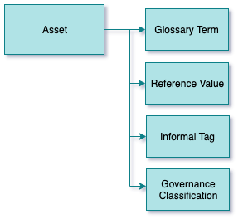
Classifiers
Classifiers add labels and properties to the asset that identifies them as part of a specific group, or having particular characteristics.
The types of classifiers are:
Glossary terms define the meaning of concepts and activities. When a glossary term is attached to a data field in the assets schema, it signifies that the data stored in that field has the meaning described in the glossary term.
Reference values identify sets of valid values of particular characteristics of the assets. For example, attaching a reference code for “personal data” to an asset indicates that it contains personal data.
Informal tags are labels that asset consumers create and attach to the asset and its data fields/operations. This is effectively a way of crowd sourcing knowledge about the asset.
Governance classifications provide formal classifiers for confidentiality, retention, confidence and criticality for the asset.
Usage
Classifiers help to make assets more findable. They also identify which assets should be treated to certain types of processing. For example, data fields marked as sensitive could be masked when added to a sandbox.

Slide 15
Using classifiers
The classifiers can be added to any Referenceable.
A referenceable is a metadata element with a unique qualified name.
Assets are referenceables, so are elements of a schema, connections and many of the types of elements that can be attached to an asset.
This means, for example, classifiers the whole asset or a specific field or operation in the schema.

Slide 16
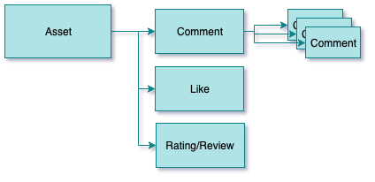
Feedback
Feedback, such as comments, likes, star ratings and reviews can be added to an asset, typically by consumers of the asset to share experiences, expertise and concerns about the asset.
The author of the feedback can choose whether it is public or private feedback. Public feedback is visible by everyone. Private feedback is visible to the author of the feedback and the owner of the asset.
Feedback can only be changed by the author of the feedback and specific moderator roles of the object it is attached to (such as asset owner for assets).
Usage
Feedback helps to share expertise and use the experience of the assets’ consumers to improve the quality of both the asset contents and its description.

Slide 17
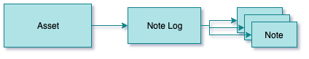
Note Logs
Note logs consist of a series of posts (called notes) that are added over time (like a blog).
Usage
Note logs can be used by the asset owner or operations team to post status or usage information about the asset to inform individuals who are using the asset of important information.

Slide 18
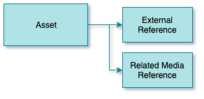
External Descriptions
Not everything that is known about an asset is stored in Egeria. There may be documents, web resources, images, videos and audio files that provide more detail.
Usage
Using the links to external resources, an individual can learn a lot more about the asset they are considering to use to complete their task.

Slide 19
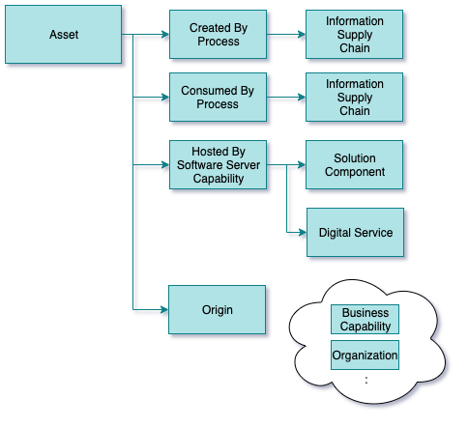
Asset Lineage
Lineage describes the origin of the data that is held by the asset. There are different perspectives on what is meant by ‘origin’.
Data often flows from asset to asset via processes. The end-to-end flow of data is called an information supply chain.
The asset itself is hosted by a software capability that is part of a server. Another perspective on the asset’s origin is the server capability that is hosting it.
Software server capabilities can be linked to a solution component or digital service. These descriptions add business context to the software server capability definitions.
Finally, the asset can include identifiers of other metadata elements from the catalog. This includes:
Unique identifier (GUID) of the business capability that owns the asset. Examples of a business capabilities include “Finance”, “Human Resources”, “Manufacturing”, “Sales”, etc
Unique identifier (GUID) of the organization that owns the asset. This could be a unit within the organization or an external organization.
Usage
Lineage information helps consumers (individuals and/or automated processes) make choices about which is the appropriate asset to use for a certain task. It gives a sense of whether the asset contains data from an authoritative source/business capability/organization/process.
Regulations that require specific types of reports often require lineage as well as the report to help the regulators validate that the report is correct.

Slide 20
Information Supply Chain
The end to end flow of a particular type of data.
Operational Systems Zone
Data Lake
Governance Catalog (Metadata) Zone
Optimized to improve timeliness, remove inconsistencies, reduce cost
Discovered through metadata …

Slide 21
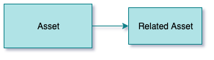
Related Assets
Related assets returns other assets that are linked together or are part of the same collection.
Collections allow individuals and automated processes to maintain groups of related assets. For example, an individual may maintain a collection of their favorite assets. A project team may maintain a collection of the assets in use by the project. An automated process may use the retention classification to build a collection of assets that need to be archived.
In addition, there are natural relationships between assets that are created as the asset is cataloged. For example, a file is related to the folder (also known as a directory) it is located in.
Usage
The related assets enables individuals or automated services to locate assets that are related. For example, a process may use the related assets to step through and process the cataloged files in a folder, or the assets in a particular collection.

Slide 22
Summary
Making it easier to locate the right asset for a task.
Improving an individual’s understanding about how an asset can be used and how it should be maintained.
Identifying assets that are supporting specific situations and business contexts.
Providing a perspective on how many assets of a certain type or situation are owned by the organization.
Providing encoded information that enables automation to be used to maintain and protect the assets.

Slide 23
Automating Catalog Maintenance

Slide 24
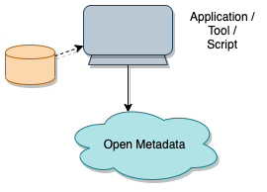

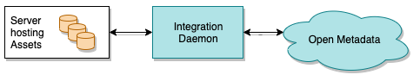
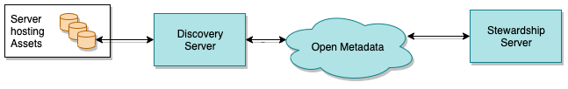
Automating catalog maintenance
Manual
Templated
Integrated
Discovery and Stewardship

Slide 25
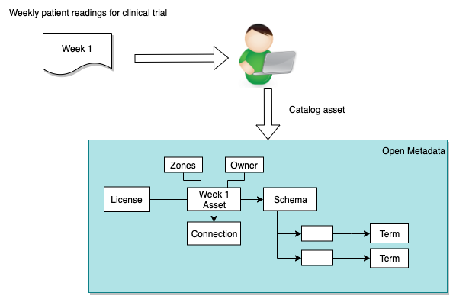
Manual cataloging weekly patient readings
Peter Profile is issuing calls to add the week 1 patient readings.
Week 2 he gets to do it all over again
And in week 3 …

Slide 26
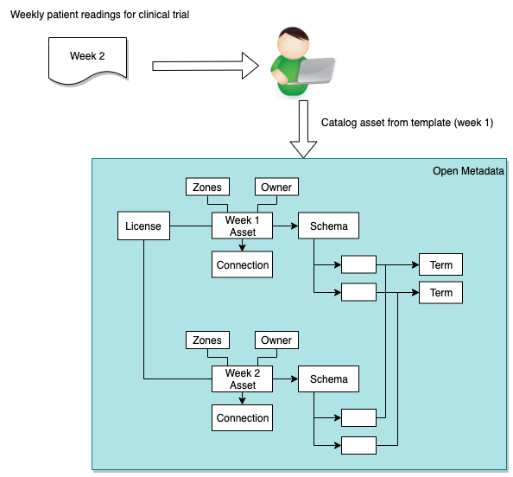
Templated Cataloging
For assets that are similar, it is possible to use a template that allows new assets to be cataloged with a single call.
The template is set up in Egeria.

Slide 27
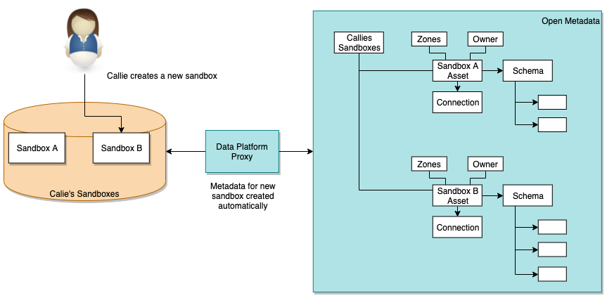
Integrated cataloging
Callie has a database server that she uses to analyze relational data.
She creates a new sandbox for each type of analysis
The data platform proxy automatically catalogs the sandbox.

Slide 28
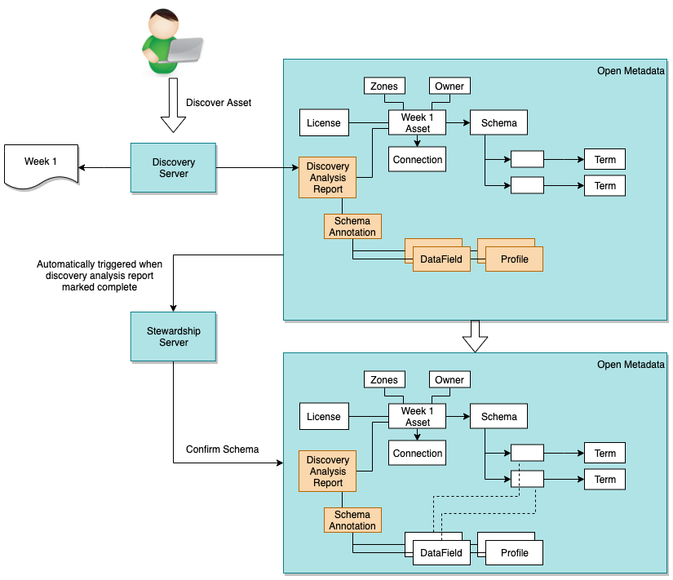
Discovery and Stewardship
Discovery creates new insights about an asset and stores them as annotations linked to the asset.
Stewardship manages the transition of annotations to standard metadata elements.
With steward interaction
Completely automatically

Slide 29
Additional Roles using the Asset Catalog

Slide 30

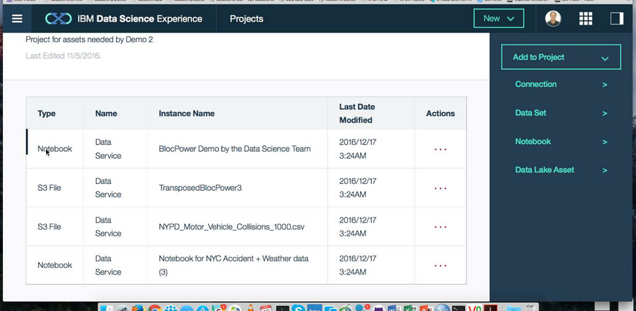
A catalog should bring as much information about the data sets to Callie’s data science as is known collectively by the organization.
X
Column: Band
X
Data Set Name: Employee Directory
X
Characteristics
Lineage
Description
Position reference number for non-exempt employees. The value ranges from 01 to 06 where 01 is the most senior and 06 is the most junior.
Description:
Core attributes describing all employees of Coco Pharmaceuticals created from a daily extract from Kenexa.
Owner: Penny Payer
Classification Ranges:
Confidentiality: Public, Confidential, Sensitive
Confidence: Authoritative
Retention: Indefinitely
Type: String
Classification: Public
Status:
Last accessed: 6th May 2016
Records: 3488
Last Update: 1st May 2016
Employee Directory
Name
Band
Job Title
Contents:
Structure …
Contents …
Lineage …

Slide 31

Different personas need different services
Callie Quartile
Data Scientist
Find data
Understand data
Manage analytics models
Build data strategy
Define governance program
Monitor progress
Jules Keeper
Chief Data Officer

Slide 32


Different personas need different services
Faith Broker
HR and Privacy Officer
Locate personal data
Ensure protection of personal data
Understand employee needs
Maintain “safe” IT Infrastructure
Build and deploy “good” APIs and services
Locate and resolve issues fast
Gary Geeke
IT

Slide 33


Different personas need different services
Tanya Tidie
Clinical Trials Administrator
Maintain accurate patient records
Catalog clinical trials data
Demonstrate good data management practices
Understand risks to organization
Set up protection
Monitor for suspicious activity
Ivor Padlock
Chief Security Officer

Slide 34





The data driven organization …
Collaborating across all 3 lifecycles
Governance Teams
Policy
Policy
Audit
Define
Asset Owners
Enterprise Architecture
Monitor
Policy
Roll out
Classify
Operations
Policy
Metadata
Development
Stewards
Design
Execute
Business Users
Deploy
Developers
Detect
Remediate
Develop
Data Scientists
DevOps

Slide 35
Open forum
z
z
z
z
z
z
z
Questions?

Slide 36
Links
Press Release and Podcast
Open source repositories
https://www.linuxfoundation.org/press-release/2018/08/odpi-announces-egeria-for-open-sharing-exchange-and-governance-of-metadata/
https://roaringelephant.org/2018/09/25/episode-107-open-metadata-and-governance-masterclass-with-mandy-chessell-part-1/
https://roaringelephant.org/2018/10/09/episode-109-open-metadata-and-governance-
masterclass-with-mandy-chessell-part-2/
https://github.com/odpi/data-governance
https://github.com/odpi/egeria

Slide 37
